Slide 1

Nucor SafeSpot
Kameron B. and John R.

Slide 2
ABOUT THE PROJECT
01
Objectives
02
TABLE OF CONTENTS
Requirements/Tools used
03
Challenges
04
Lessons Learned
05
Overview of Nucor and NSS: Understanding the purpose and significance of this initiative.
Defining the goals and expected outcomes of the project.
Key technologies and resources utilized in the project.
Obstacles encountered during development and how they were addressed.
Insights and knowledge gained from the project's journey.

Slide 3

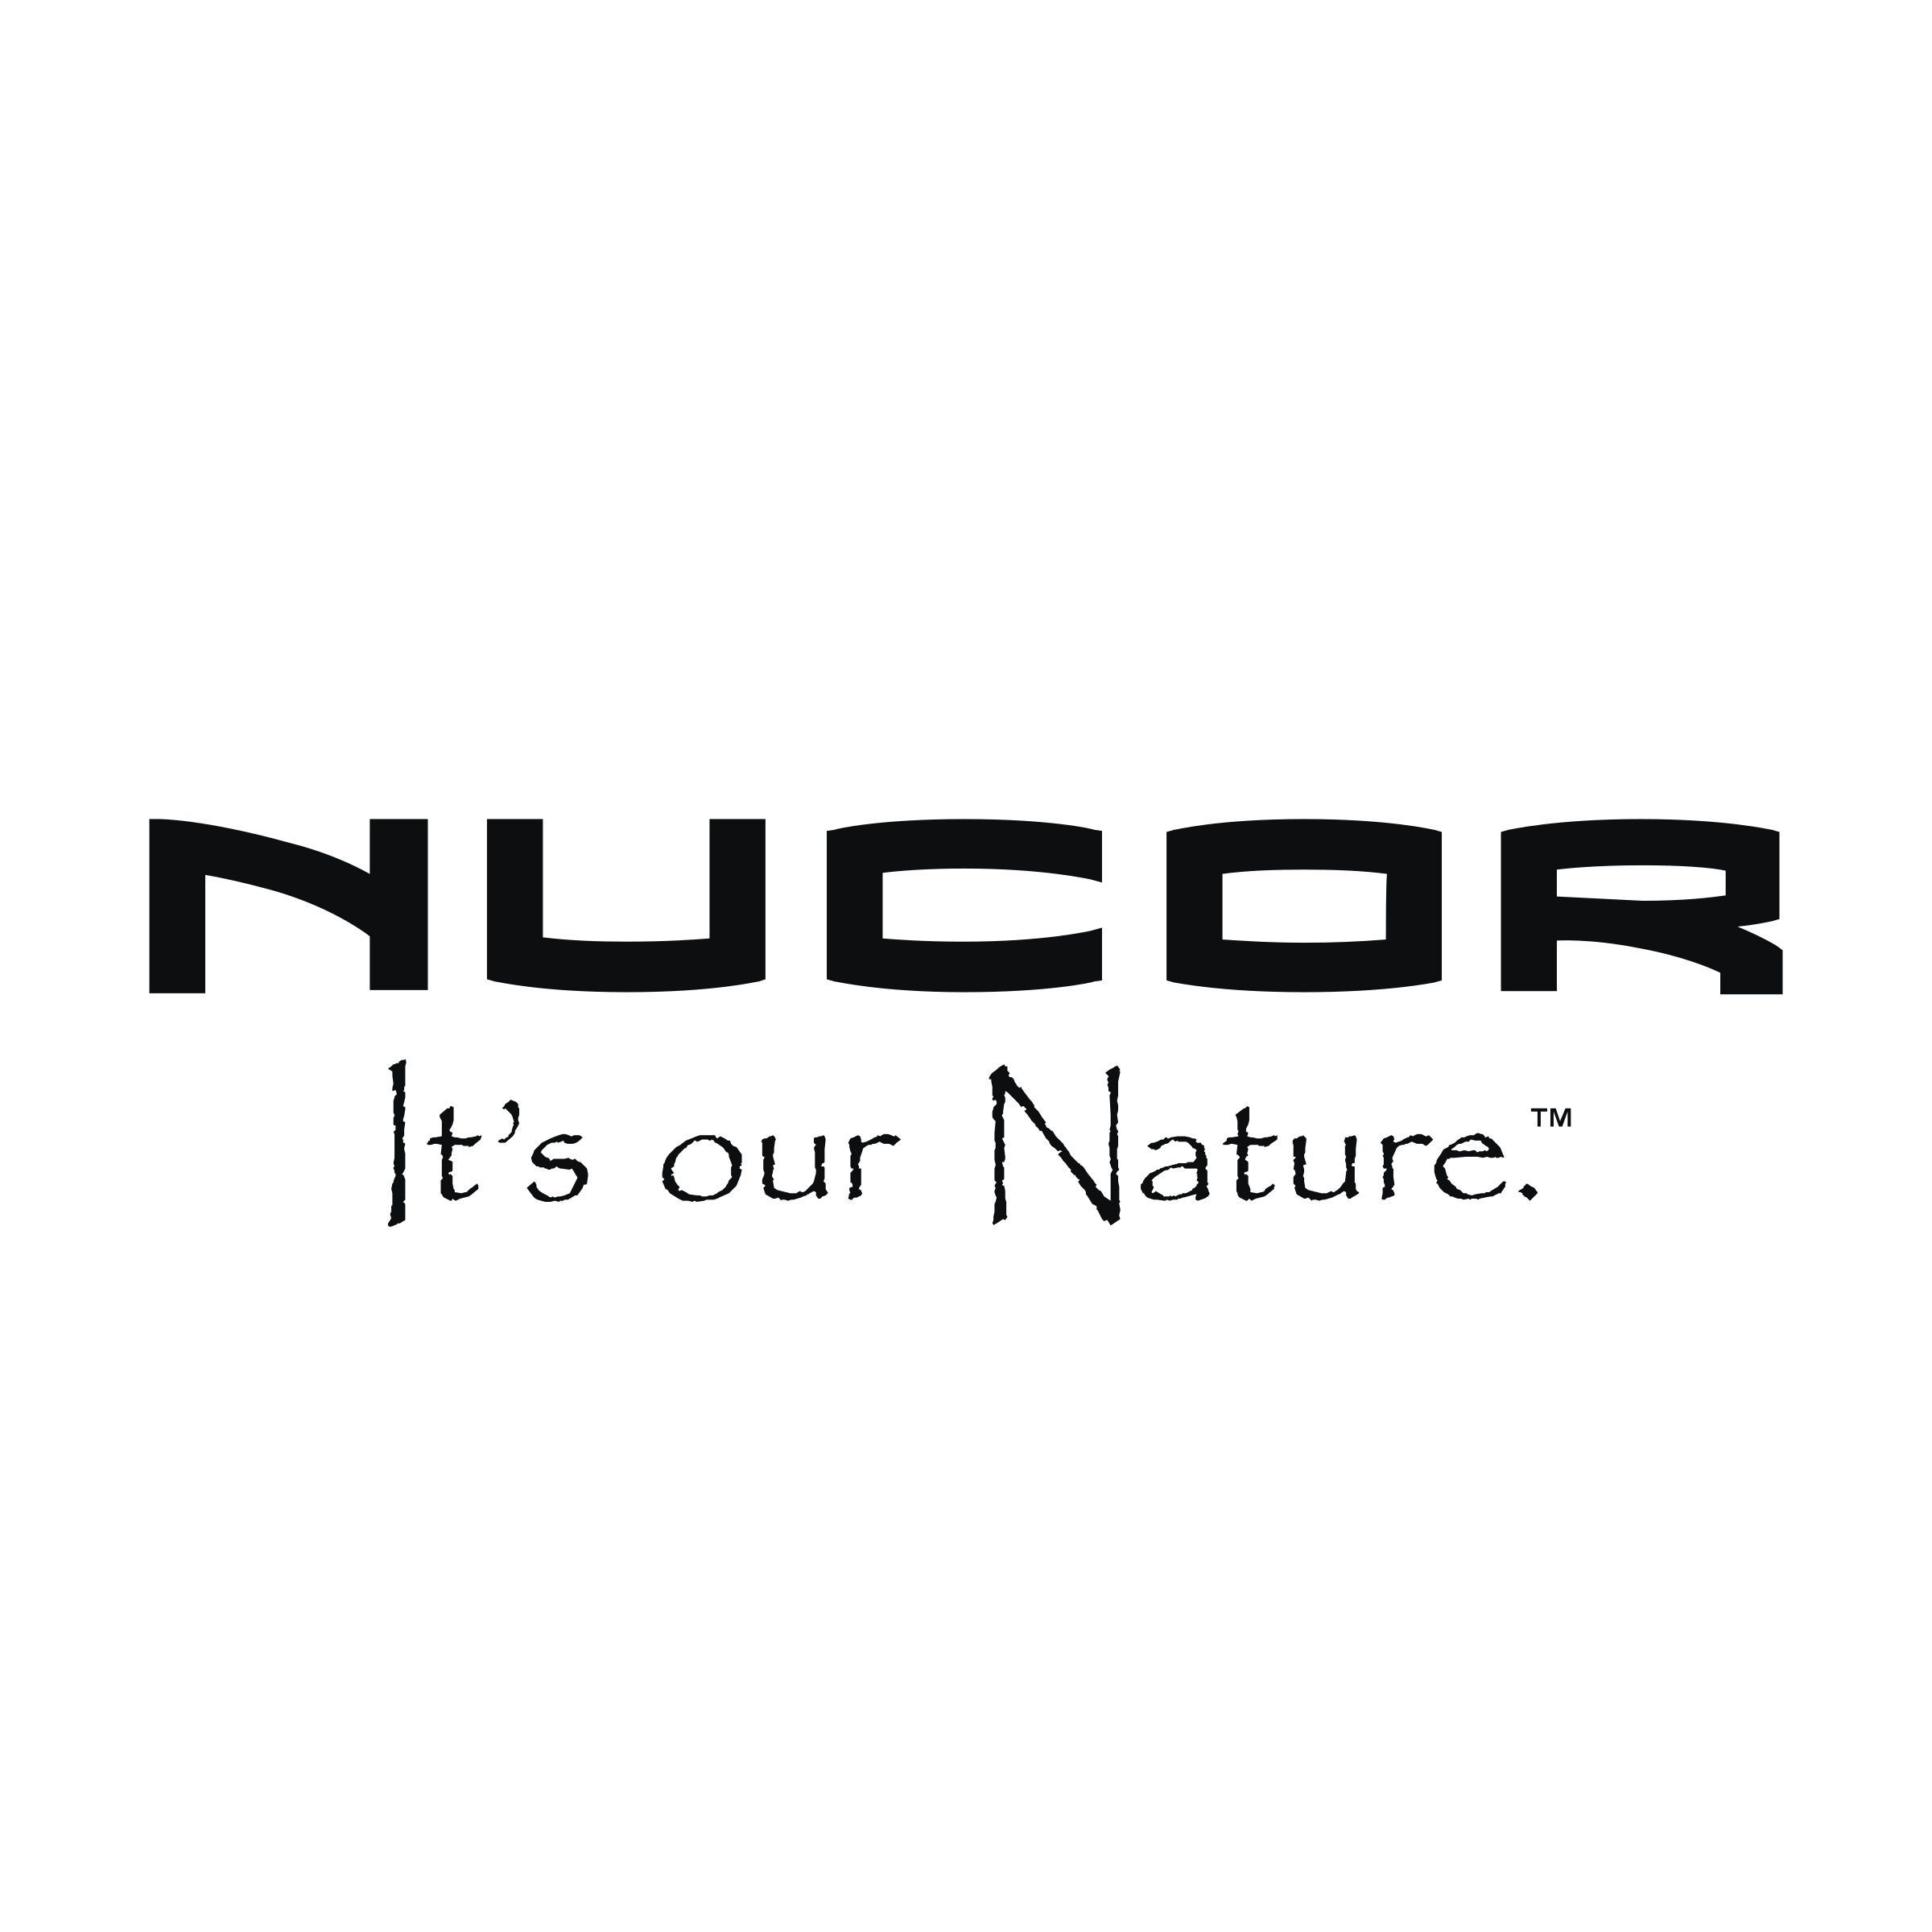
About Nucor
Nucor is a leading steel and steel products manufacturer headquartered in Charlotte, North Carolina. Nucor employs approximately 32,000 teammates worldwide. Safety is Nucor's foremost cultural value, with the company striving to become the world's safest steel company.

Slide 4

ABOUT NSS
NSS is an all-in-one PPE (Personal Protective Equipment) index.
Key Features
Displays a list of locations within a mill.
Clicking on a location provides a menu for protection type.
When the protection type is selected it displays a list of equipment respective to that protection type which are suitable for that area.
Equipment is selectable and a description of the item is displayed to the screen.

Slide 5

Objectives
Develop a user-friendly and intuitive interface.
Experiment with a new approach or technology unfamiliar to the team.
Ensure ease of updating and maintaining information.
Design for scalability to accommodate future growth.

Slide 6

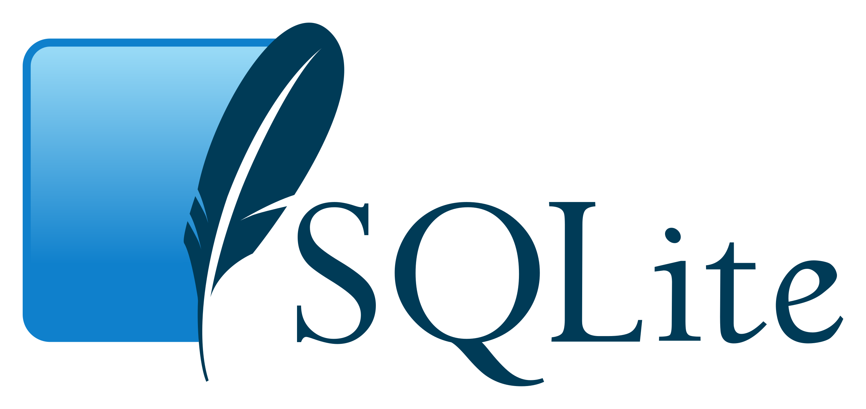


MAJOR REQUIREMENTS/Tools Used
Android Studio
Sqlite
Java
Integrated Development Environment (IDE) used for building the application.
Lightweight database management system for storing and managing application data.
Primary programming language used for application development.
GitHub
Version control and collaboration tool to manage code.

Slide 7
Challenges
Technical Challenges:
Debugging and resolving unexpected runtime errors.
Integrating SQLite database and ensuring smooth data retrieval.
Implementing new or unfamiliar technologies like Android Studio or advanced Java features.
UI Design
Ensuring the user interface is intuitive and responsive across different devices.
Balancing simplicity with functionality in the design process.
Collaboration:
Communicating effectively within a team to align on features and functionality
Managing code conflicts during collaboration

Slide 8
Lessons Learned
Technical Skills:
Gained a deeper understanding of Android Studio and its features.
Improved knowledge of SQLite for managing and querying databases.
Enhanced proficiency in Java programming for building robust applications.
Designs Principles:
Understood the importance of creating a clean, intuitive, and user-friendly interface.
Recognized how crucial it is to balance design simplicity and functionality.
Scalability and Maintenance:
Understood the importance of designing an app that is easy to update and scalable for future needs.
Learned to write clean, modular code to make future maintenance more manageable.

